Slide 1








TEAM:03
CUSTOMER
TREND ANALYSIS BY FOOD BRAND
UNDER GUIDANCE OF MENTOR PAVITHRA KANNAN

Slide 2
MILES STONE 2
INTRODUCTION:
After successfully completing Milestone 1, where data from multiple sources such as surveys, social media, and reviews were cleaned, de-duplicated, and standardized into a unified data model with consistent keys, the next step focuses on extracting meaningful insights from this structured data.
In Milestone 2, the primary objective is to implement and verify sentiment analysis logic. This involves analyzing customer feedback to determine overall sentiment (positive, negative, or neutral) and identifying recurring themes based on keywords. By integrating sentiment results into the dashboard, we aim to provide a clear view of customer perceptions, highlight key trends, and uncover areas for improvement.
This milestone ensures that the dashboard not only displays quantitative data but also interprets qualitative feedback, offering a more holistic view of customer experience and supporting data-driven decision-making.

Slide 3
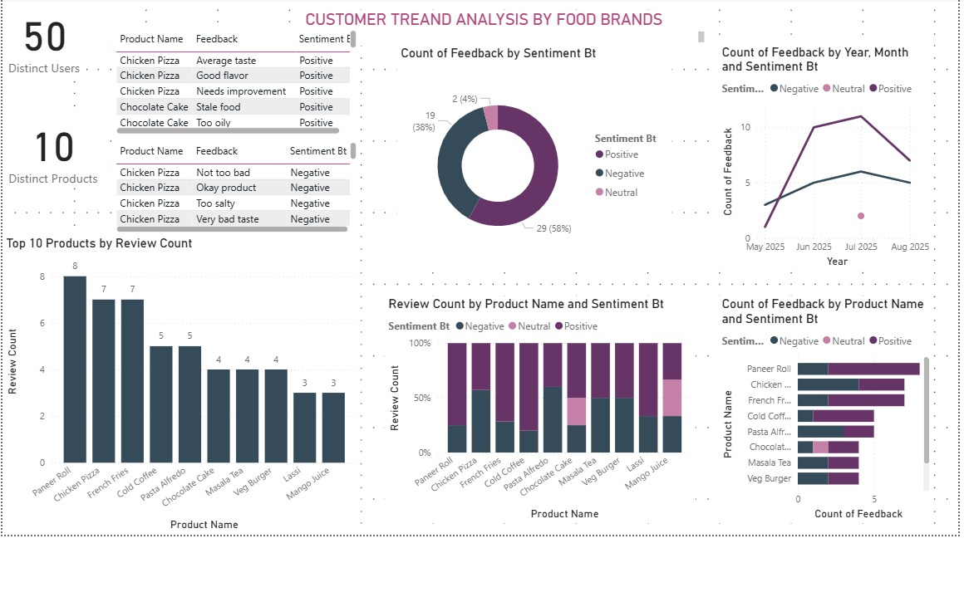
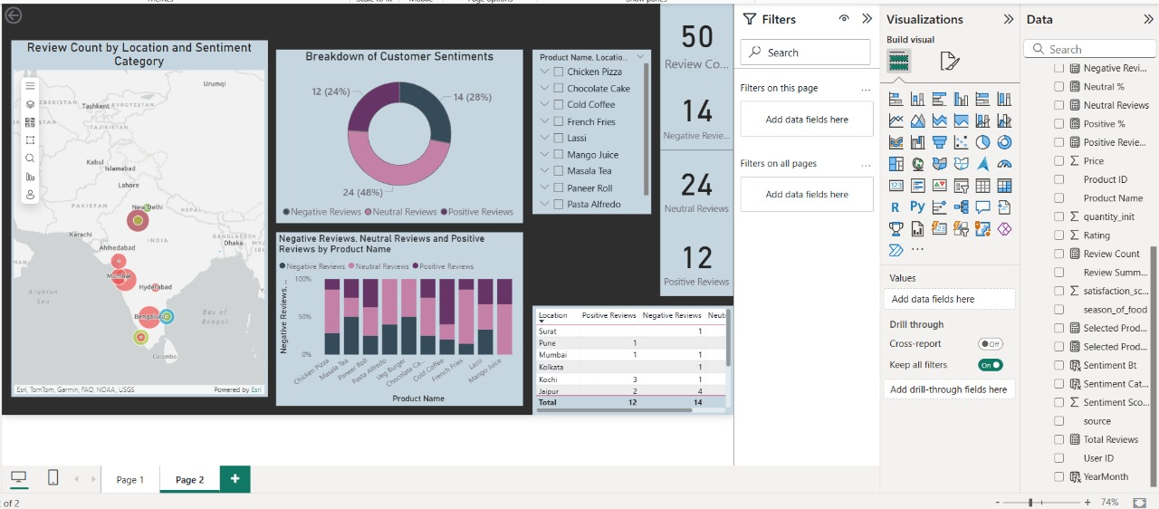
MILES STONE 2 SCREENSHOTS

Slide 4

EXPLANATION
1
2
The first dashboard visualizes customer trend analysis based on food products and sentiments. It highlights the number of distinct users and products, with detailed sentiment-wise feedback records. A donut chart shows the overall sentiment distribution, while the line chart presents feedback trends across months. Bar graphs display the top 10 reviewed products and sentiment breakdown by product, helping identify which food items attract the most reviews and how customer opinions vary. This dashboard provides insights into both product popularity and customer satisfaction trends.
The second dashboard focuses on geographical and sentiment-based insights. It features a map showing review counts by location and sentiment category, highlighting regional customer preferences. A donut chart breaks down total customer sentiments into positive, neutral, and negative categories. Supporting visuals include a bar chart comparing sentiment distributions across products and a table showing location-wise review counts. This dashboard provides a clear view of how customer feedback varies across different cities and products, offering valuable insights for regional product performance and targeted improvements.

Slide 5
MILES STONE 1 & 2 COMPARISON
In this stage, the main goal was to extract insights through sentiment analysis. We implemented and verified sentiment analysis logic to evaluate customer feedback, categorizing it into positive, negative, and neutral sentiments. A dashboard was then developed to present overall sentiment trends along with keyword-based themes, providing a comprehensive understanding of customer perceptions. This milestone transformed the cleaned data into actionable insights through visualizations and sentiment-driven analytics.
In this phase, we focused on preparing the data for analysis. Data sources were collected from surveys, social media, and customer reviews, then cleaned to remove duplicates, inconsistencies, and noise. The datasets were standardized and transformed into a unified data model with consistent keys such as product_id and user_id. This ensured that the data was validated, reliable, and ready for subsequent analysis and visualization tasks.

Slide 6
THANK YOU
From Feedback to Insights: Mapping the Customer Journey
WE WELCOME YOUR QUERIES

